Slide 1

Project Output
Integrated Menus and sub menus
Ali Hassan
22021519-013
To: Muhammad Usman Ali

Slide 2
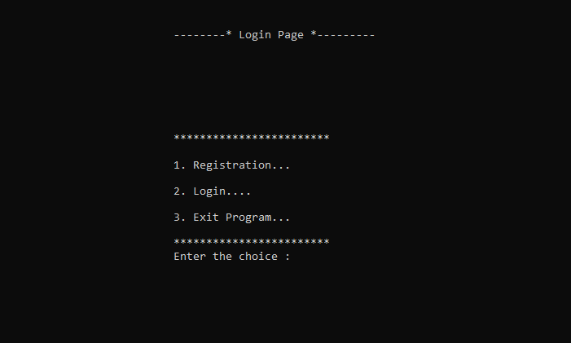
It will take to the page where the user will be askes to create a new account.
It will take to the page where the user will be asked to enter the already created account to login..
It will simply close the program.

Slide 3
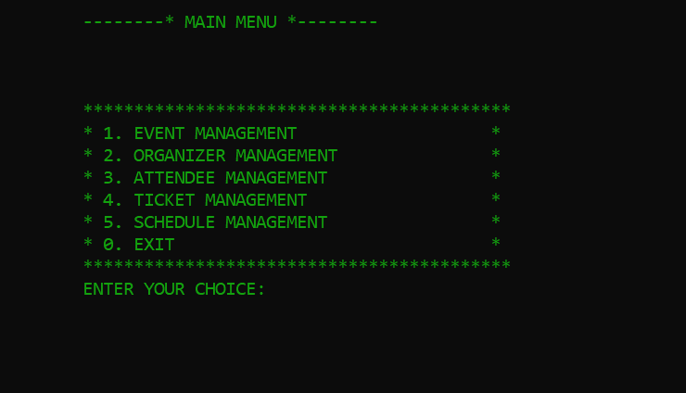
This is the main menu of the system.
This will control all the event operations
This will control all the organizer operations.
This will control all the attendee operations.
This will control all the tickets operations.
This will control all the schedules operations.

Slide 4
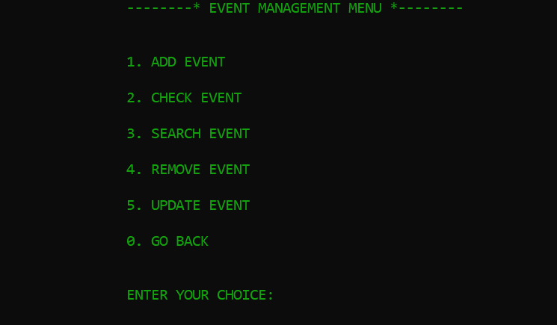
This is the sub-menus integrated with Even-management
Add the new events to the system
This will show the list of the added events.
This will search the particular events from the system.
This will remove the event from the system.
This will update the event from the system.

Slide 5
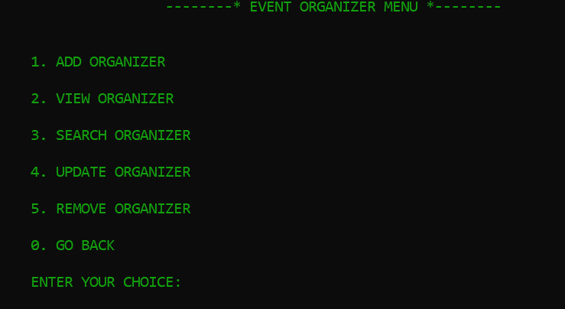
This is the sub-menus integrated with Organizer-management
This will add the new organizers to the system and associate them with the given ID event.
This will display all the organizers from the system and show that which organizer is associate to which event,
This will search the given id organizer,
This will update a organizer and the event associated,
This will simply remove the organizer from the system.

Slide 6
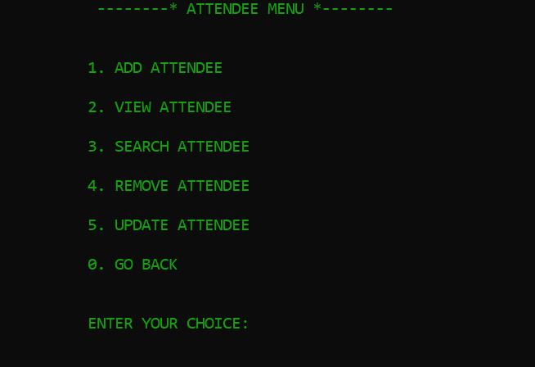
This is the sub-menus integrated with attendee management.
This will add the attendee and associate to the event.
This will list all the attendee and show that which attendee associate to whom event.
This will simply search the attendee from the system.
This will simply delete the attendee from the system.
This will update the attendee information.

Slide 7
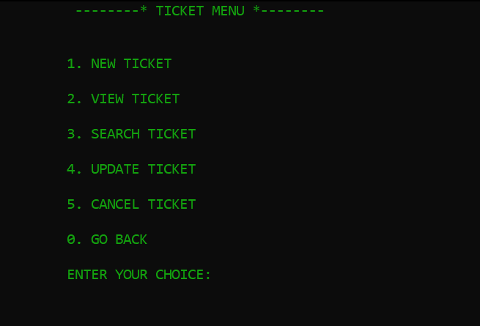
This is the sub-menus integrated with ticket management.
This will simply add the ticket and associate to the attendee.
This will list all the ticket.
This will search the ticket.
This will update the ticket.
This will cancel the ticket from the system.

Slide 8
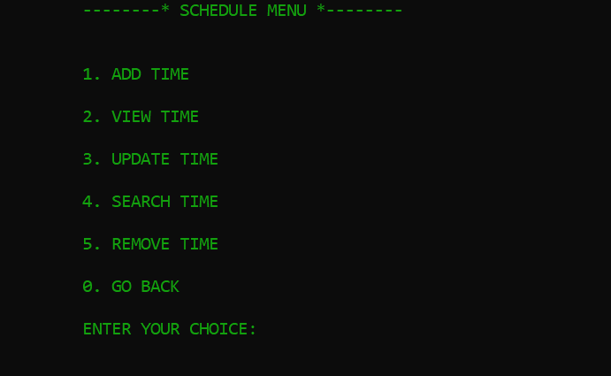
This is the sub-menus integrated with schedule management.
This will add the time and associate with event.
This will list the schedule of the associated events.
This will update the schedule details of the event.
This will search the schedule of the event from the system.
This will simply remove the schedule from the system.

Slide 9

Thank you
someone@example.com

